Slide 1
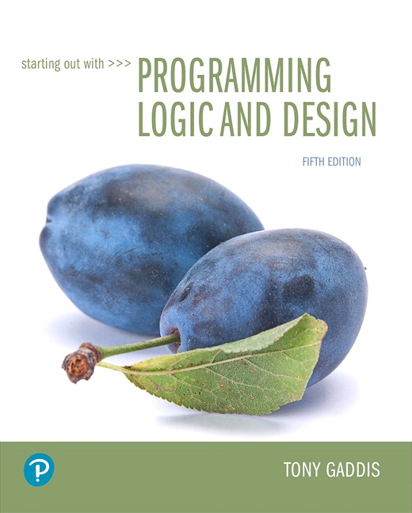
Starting out with Programming Logic and Design
Fifth Edition
Chapter 2
Input, Processing, and Output
Copyright © 2016, 2013, 2010 Pearson Education, Inc. All Rights Reserved
Notes:
If this PowerPoint presentation contains mathematical equations, you may need to check that your computer has the following installed:
1) MathType Plugin
2) Math Player (free versions available)
3) NVDA Reader (free versions available)

Slide 2
Learning Objectives
2.1 Designing a Program
2.2 Output, Input, and Variables
2.3 Variable Assignment and Calculations
2.4 Variable Declarations and Data Types
2.5 Named Constants
2.6 Hand Tracing a Program
2.7 Documenting a Program
2.8 Designing Your First Program
2.9 Focus on Languages: Java, Python, and C++

Slide 3
2.1 Designing a Program (1 of 7)
The first step in programming is designing – flow charts and pseudocode help with this process.
Next, the code is written.
All code must be cleared of all syntax errors.
After the executable is created, it can be checked for logic errors.
If logic errors exist, the program must be debugged.

Slide 4
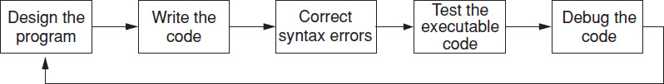
2.1 Designing a Program (2 of 7)
The purpose of Programming Logic and Design is to focus on Flow charts and Pseudocode.
The design is the foundation of a good program.
Figure 2-1 The program development cycle

Slide 5
2.1 Designing a Program (3 of 7)
Two steps in designing a program
Understand the tasks that the program is to perform.
Learning what the customer wants.
Determine the steps that must be taken to perform the task.
Create an algorithm, or step-by-step directions to solve the problem.
Use flow charts and/or pseudocode to solve.

Slide 6
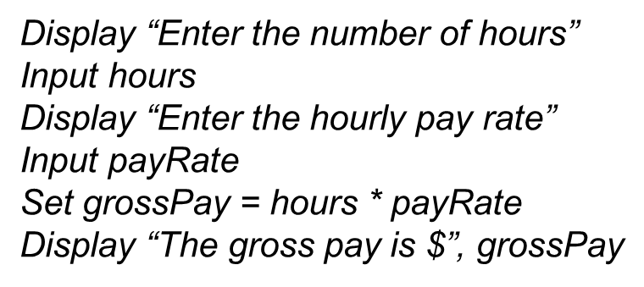
2.1 Designing a Program (4 of 7)
Pseudocode
Fake code used as a model for programs
No syntax rules
Well written pseudocode can be easily translated to actual code

Slide 7
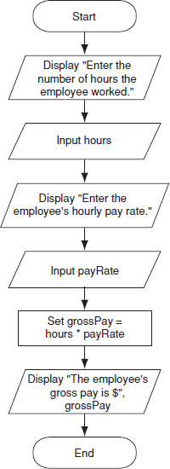
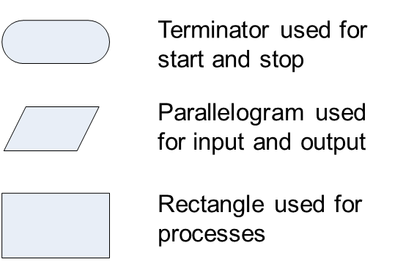
2.1 Designing a Program (5 of 7)
Flow charts
A diagram that graphically depicts the steps that take place in a program
Figure 2.2 Flow chart for the pay calculating program

Slide 8
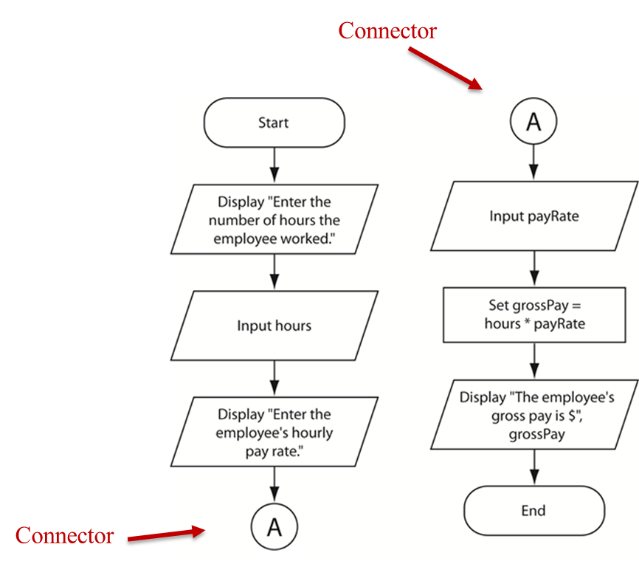
2.1 Designing a Program (6 of 7)
Flow chart Connector Symbol
Use connectors to break a flow chart into two or more smaller flow charts, and placing them side-by-side on the page.

Slide 9
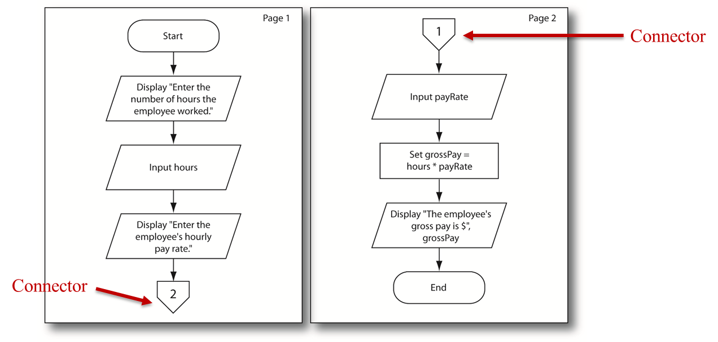
2.1 Designing a Program (7 of 7)
Off-Page Connector Symbol
To connect flow charts on different pages

Slide 10
2.2 Output, Input, and Variables (1 of 6)
Output – data that is generated and displayed
Input – data that a program receives
Variables – storage locations in memory for data
Computer programs typically follow 3 steps
Input is received
Some process is performed on the input
Output is produced

Slide 11
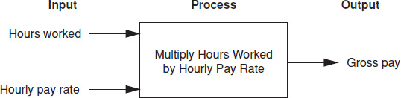
2.2 Output, Input, and Variables (2 of 6)
Input, Processing, and Output of a Pay Calculating program:

Slide 12
2.2 Output, Input, and Variables (3 of 6)
I P O Chart: Describes the input, processing, and output of a program.
Example:
I P O Chart for the Pay Calculating Program
Input | Processing | Output
Number of hours worked Hourly pay rate | Multiply the number of hours worked by the hourly pay rate. The result is the gross pay. | Gross pay

Slide 13
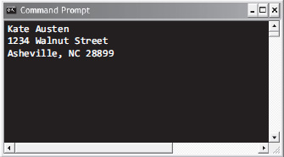
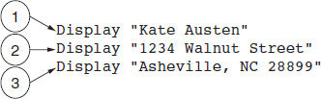
2.2 Output, Input, and Variables (4 of 6)
Display is the keyword to show output to the screen
Sequence – lines execute in the order they appear
String Literals – a sequence of characters
Figure 2-7 The statements execute in order
Figure 2-8 Output of Program 2-1

Slide 14
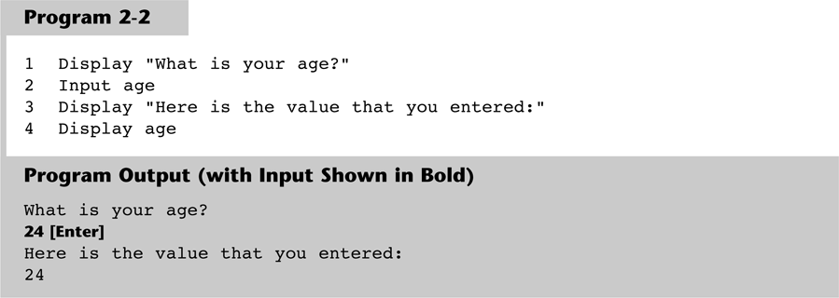
2.2 Output, Input, and Variables (5 of 6)
Input is the keyword to take values from the user of the program
It is usually stored in variables

Slide 15

Copyright

